Slide 1
Nucleic acid hybridization on an electrically reconfigurable network of gold-coated magnetic nanoparticles enables microRNA detection in blood
March 7, 2022
Chunlin Min

Slide 2
Outline
Background
Voltammetry
MicroRNA and miR-21
Paper Introduction
Au@MNP
Procedure & Assembly
Range of detection & selectivity
Detection Mechanism
Examining capability of sensor
Conclusion
Opinions

Slide 3
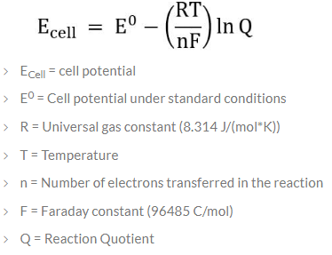
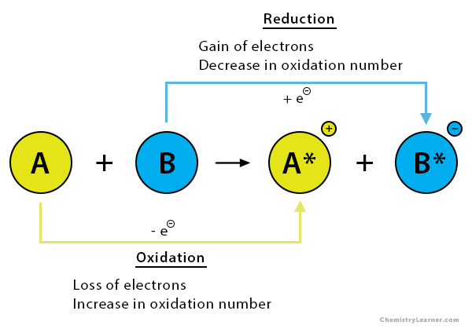
Voltammetry
Voltammetry
Electroanalytical method based on study of current as a function of applied voltage to obtain information about an analyte
Studies oxidation-reduction (redox) reactions
Based on Nernst equation
relates cell potential and redox product/reactant concentrations

Slide 4
Voltammetry: How does it work?
By Nernst equation, if the cell potential is changed then to balance the equation, Q must change as well
System is disturbed, redox reaction is forced to occur
Current is measured at the working electrode
Current magnitude is proportional to applied voltage and analyte concentration

Slide 5
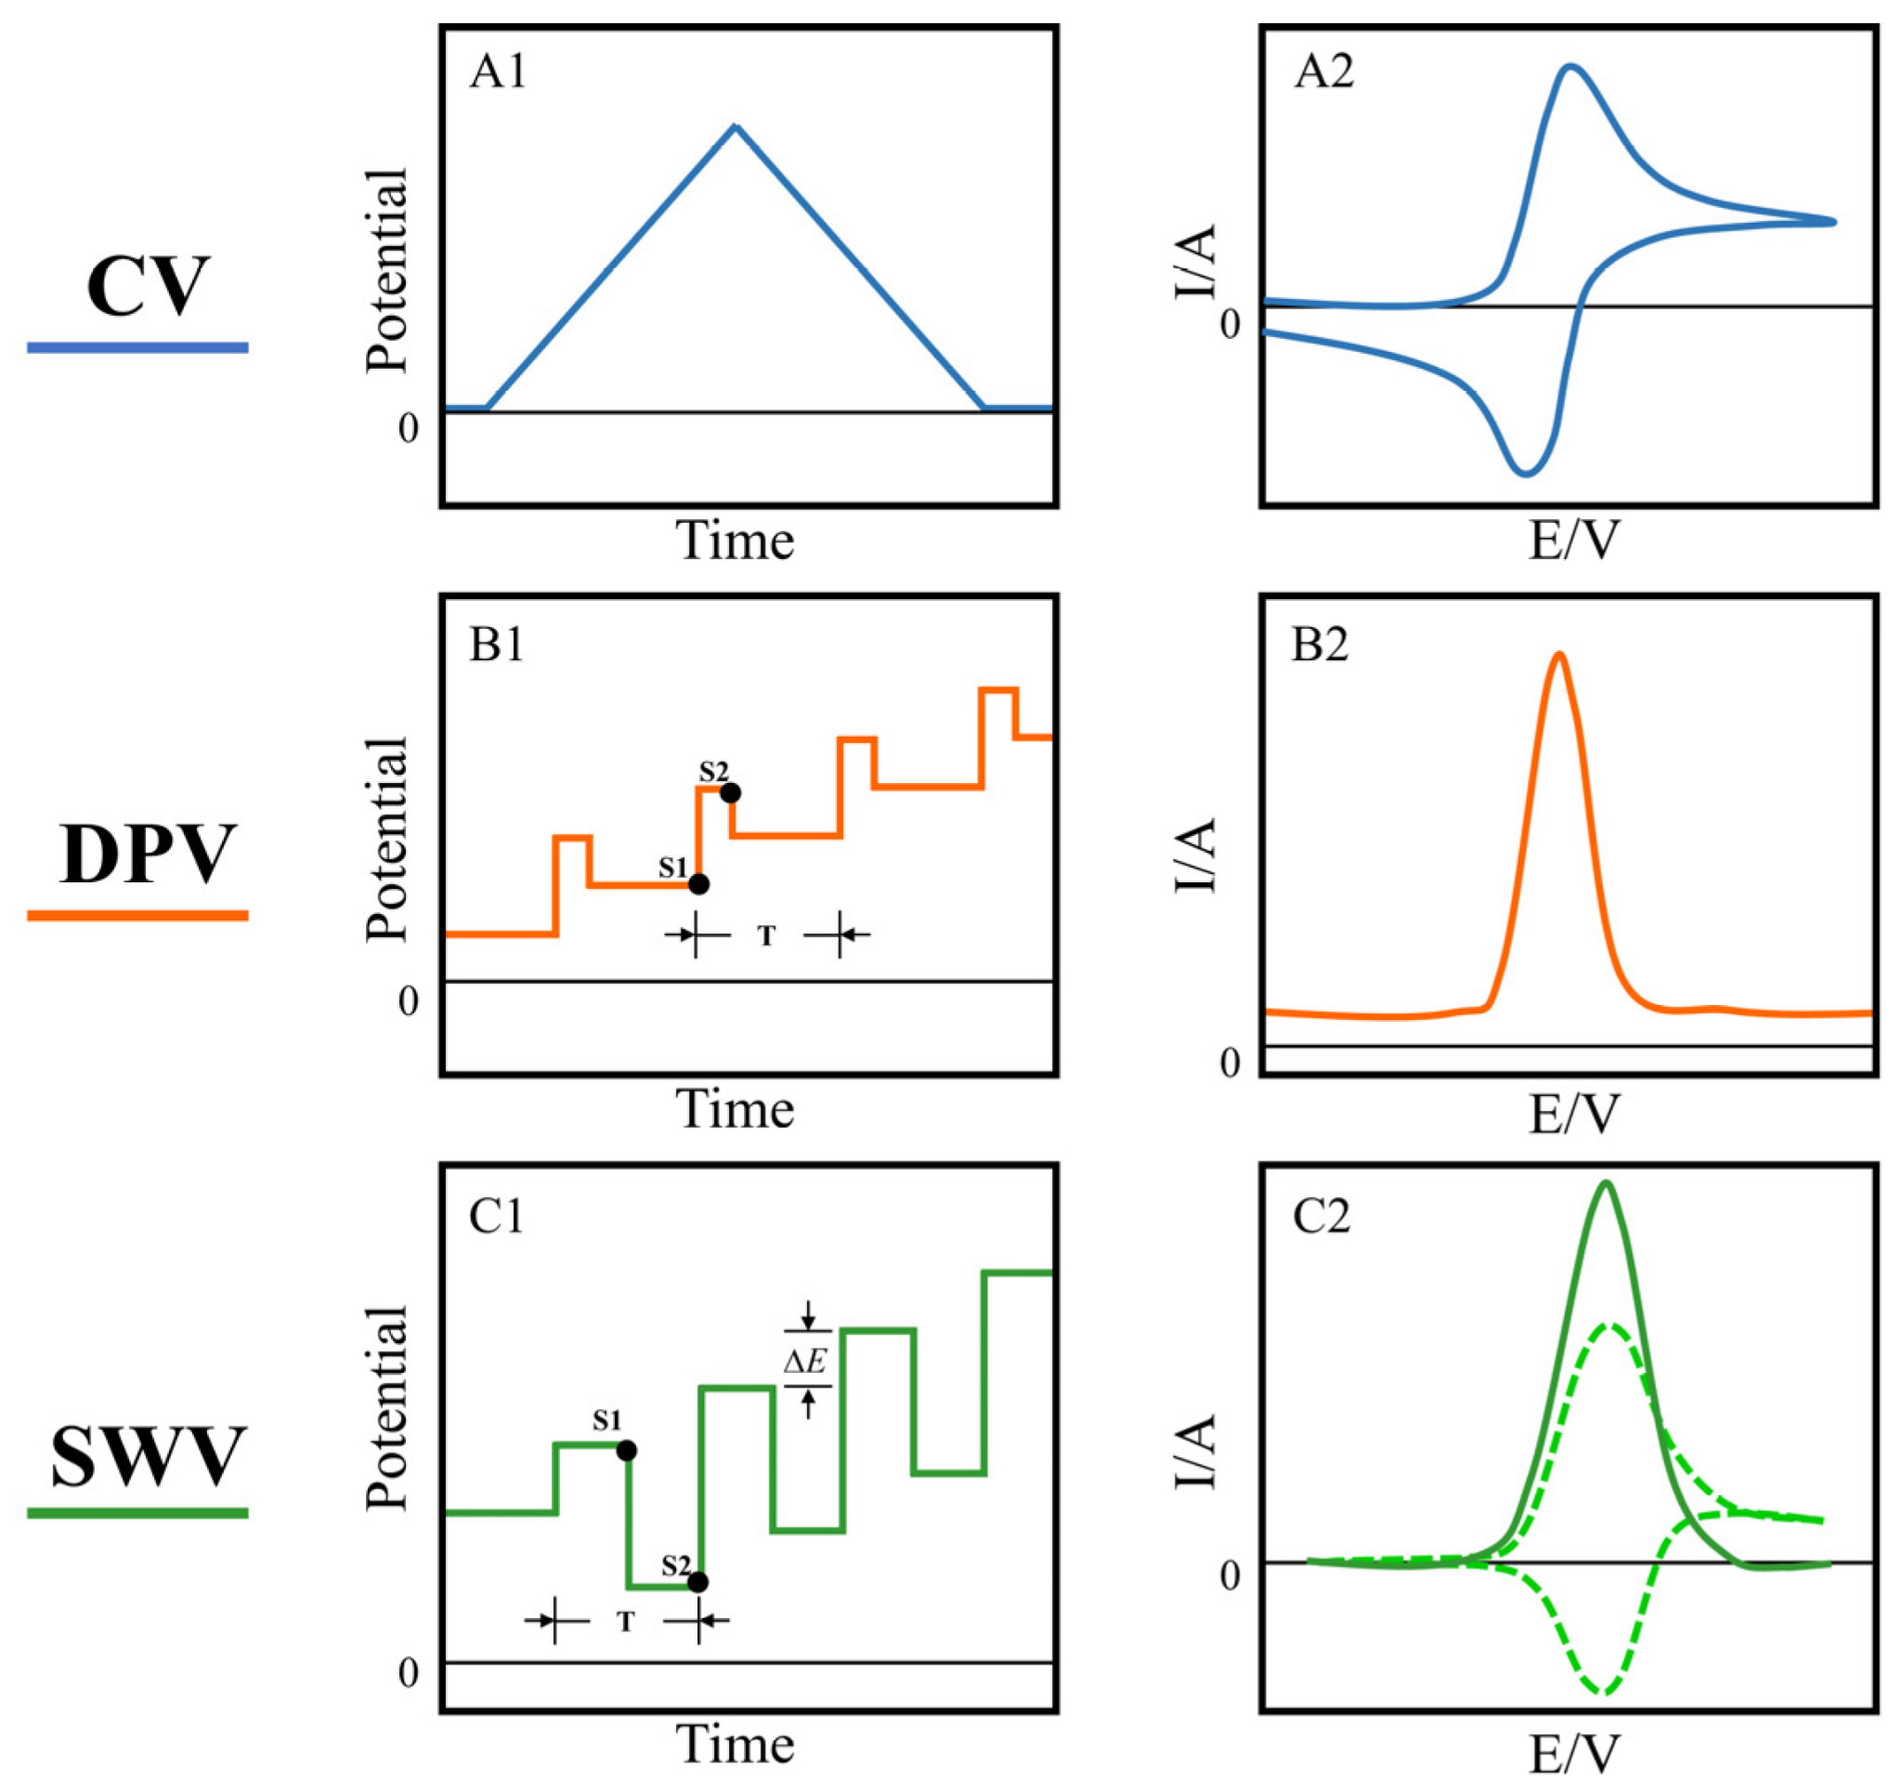
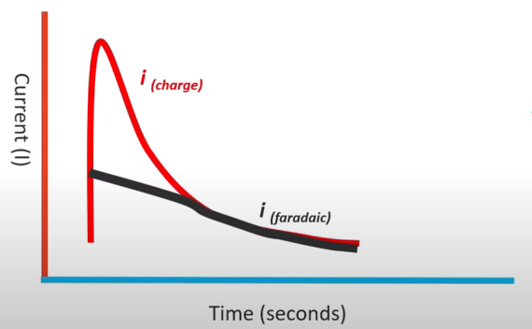
Types of Voltammetry
Cyclic voltammetry (CV)
Square wave voltammetry (SWV)
Differential pulse voltammetry (DPV)
One challenge is to measure the Faradic current and distinguish it from capacitive current
Notes:
Faradic current is due to electrochemical reaction, capacitive current is due to physics (movement of existing ions/charges in solution)

Slide 6
MicroRNA
microRNAs (miRNAs) are small sequences, ~21 nucleotides long, of non-coding RNA that regulates gene expression
Stable in bodily fluids, which is a good characteristic as a biomarker
miRNAs control gene expression post-transcriptionally by hybridizing to target mRNAs to disrupts protein synthesis
Either it inhibits translation process or cuts off mRNA
One miRNA can bind to several or hundreds of target mRNAs
Abnormal levels of miRNA may lead to diseases such as cancer
YouTube video “Gene Silencing by microRNA” https://youtu.be/t5jroSCBBwk

Slide 7
MicroRNA-21
MicroRNA-21 (miR-21) is a very popular biomarker used in studies
Linked to at least 29 cancer and non-cancerous diseases [1]
Usually found to be upregulated or highly expressed in cancer
Plays a role in cell proliferation, migration, invasion and apoptosis
miR-21 can be found in most cell types and can be easily measured in bodily fluids (blood, urine, saliva)

Slide 8
Paper Introduction
This paper presents a method using a network of gold coated magnetic nanoparticles (Au@MNP) modified with probe DNA (DNA-Au@MNP) to detect concentrations of microRNA from 10 aM to 1 nM in unprocessed blood samples
Detecting low levels of circulating microRNA in blood has important diagnosis and prognosis values
early detection of cancer, monitor disease progression, etc
Immense interest in quantifying microRNA across broad ranges and in ultra low amounts using direct analysis from whole blood

Slide 9
DNA-Au@MNP
Magnetic properly allows the nano sensor to seek out analyte (dispersible electrodes) rather than waiting for analyte to diffuse to the sensor
Increases sensitivity and deduces diffusion wait time (especially for low analyte concentration)
Fabrication of Au@MNP is described in a paper from 2009
Fabrication and Dispersion of Gold-Shell-Protected Magnetite Nanoparticles: Systematic Control Using Polyethyleneimine [2]
Surfaces of Au@MNP were modified with a probe DNA complementary to target miR-21
Prove DNA has thiol modification at one end and methylene blue redox label at the other
Probe DNA: 5′-SH-(CH2)3-p-TCAACATCAGTCTGATAAGCTA-(CH2)3-MB-3′
Complementary RNA target (miRNA-21): 5′-UAGCUUAUCAGACUGAUGUUGA-3′

Slide 10
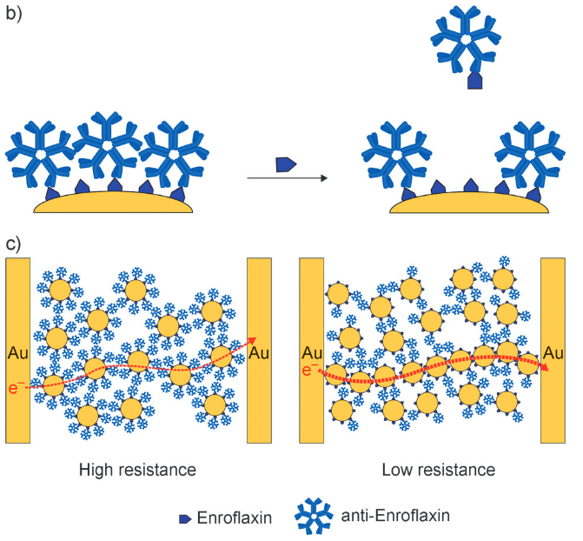
Au@MNPs property as a Biochemiresistor
First introduced in “The biochemiresistor: an ultrasensitive biosensor for small organic molecules” [3]
Example from [3] (diagram)
(b) Ab-Au@MNP surface is modified with anti-enrofloxacin antibody
When target is enrofloxacin is present in solution, surface anti-enrofloxacin can dissociate from surface bound enrofloxacin
(c) Higher target concentration => lower resistance

Slide 11
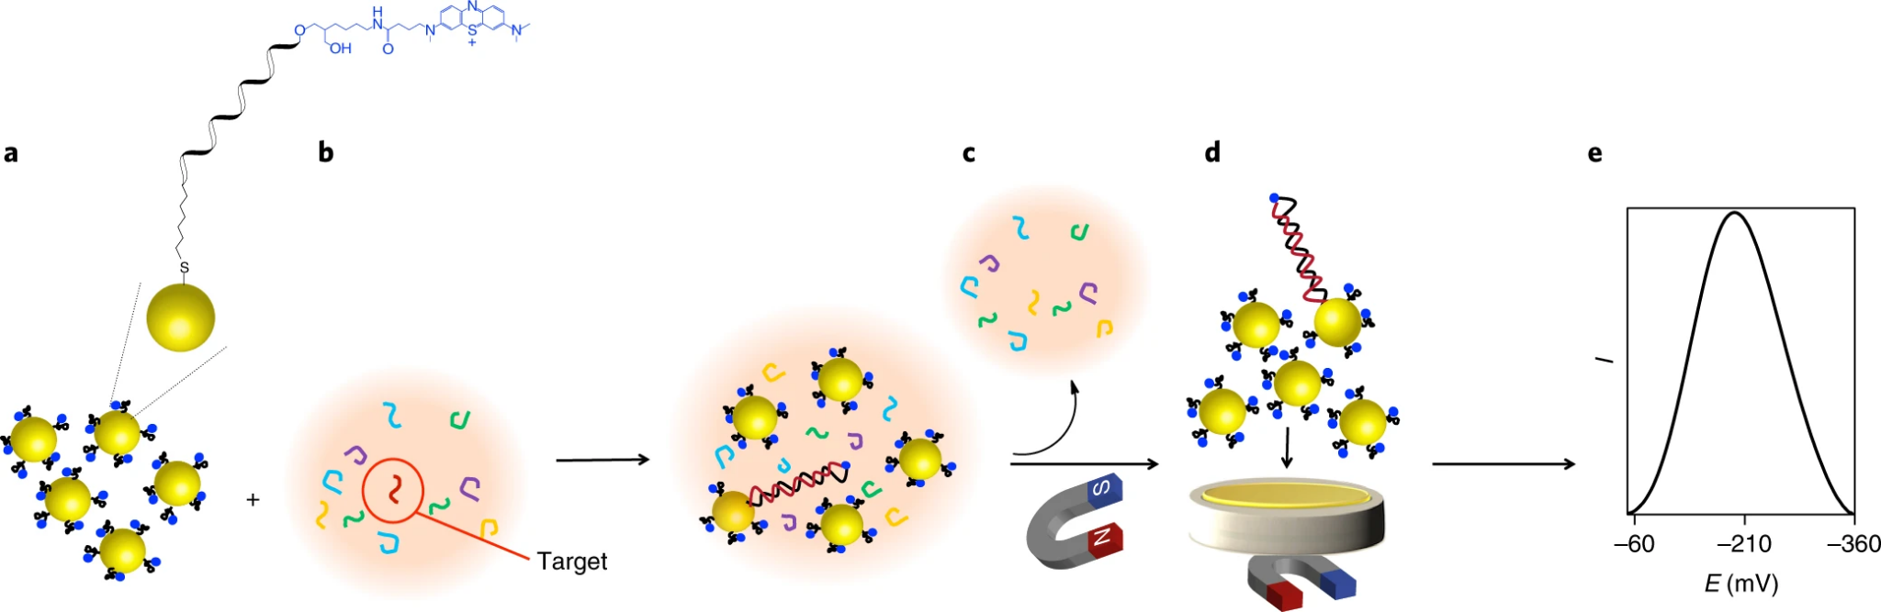
Procedure
DNA-Au@MNPs are incubated for 30 min with 2 mL of target miRNA solution while gentle mixing in the rotating wheel
DNA-Au@MNPs are then collected magnetically onto gold microelectrode and unhybridized targets are washed away
Apply 10 cycles of square-wave voltammetry in the potential range between 200 and −500 mV with pulse amplitude of 20 mV and frequency of 2 Hz
Compare peak of voltammogram to calibration curve to determine concentration of target
Notes:
Magnet removed before taking measurements

Slide 12
Assembly
Custom-made glass electrochemical cell
Gold foil (working electrode) attached to aluminum foil is placed on the bottom of the cell on top of a plastic layer
Gold foil is cleaned electrochemically in 0.05 M sulfuric acid until a reproducible cyclic voltammogram is seen
Working electrode area was estimated using reduction peak
Measurements taken at room temperature
A neodymium disc magnet was placed for 5 mins under gold foil to collect nanoparticles
For electrochemical measurements, the magnet was removed and reference (Ag|AgCl, 3.0 M NaCl) and counter (custom-made platinum flag) electrodes were introduced into the cell

Slide 13
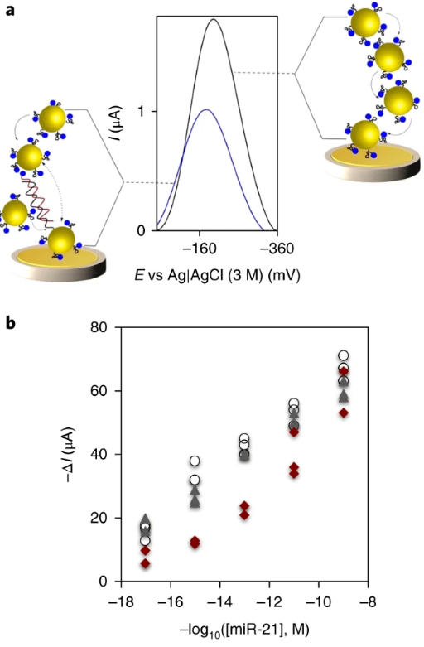
Range of Detection
Hybridization induced change in SWV peak current in three different matrixes spiked with different concentrations of target (10 aM to 1 nM)
Matrixes:
(red) 50% human blood
(grey) human serum
(white) PBS, Phosphate-buffered saline
Data collected from 50 independent experiments
Limit of detection is 10 aM
Note: Ignore the negative sign in-front of the log function for the x-axis
Notes:
Diagram (a) Square-wave voltammograms (frequency 2 Hz, pulse amplitude 20 mV) obtained before and after exposure of the sensor to 1 pM synthetic miR-21 solution
Diagram (b) calibration graph for target concentration in different matrixes
PBS has similar properties to human blood in terms or ion concentration and osmolality (solute concentration)

Slide 14
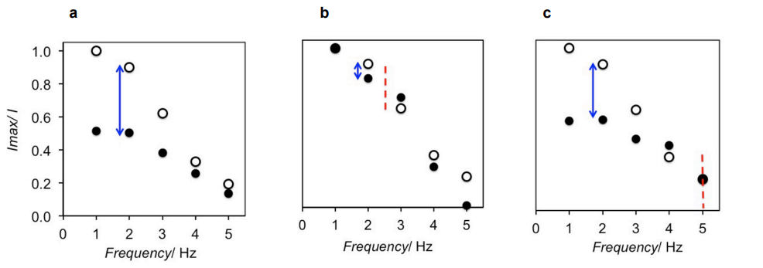
Selectivity
Diagram: change in peak current for (a) complementary targets, (b) non-complementary targets, (c) targets with single mismatch at middle position
Average 9% less of change in current for single mismatch sample compared to fully complementary sample
Ability of assay to discriminate target from related sequence
Notes:
White-dot => measurement for blank
Increase frequency => weaker signal strength, current differences are smaller
Frequency of 2 Hz was selected as the optimal based on comparison of current differences between complementary, non-complementary, and single mismatch hybridization

Slide 15
Detection Mechanism
Two hypothesis on why the sensor has low limit of detection
(1) Recap on “biochemiresistor” property of Au@MNP: hybridized probes create distance between Au@MNPs, therefore increasing path resistance or decreasing current. A limited amount of hybridized probes is enough to suppress the electrical signal of the network
(2) Electric field induced reconfiguration of the Au@MNP network redirects hybridized particles closer to electrode surface, which helps to amplify signal suppression

Slide 16


Evaluating Hypothesis 1
Area under peaks in CV helps estimate number of electrochemically-detectable redox-active molecules (amount of detectable DNA probes)
Paper used oxidation peak
n is number of electron transferred per redox event (n = 2 for MB)
F is Faraday’s constant
A is area of electrode area
v is sweep rate
(1) Randles–Sevcik equation
(2) Estimate amount of DNA probes

Slide 17
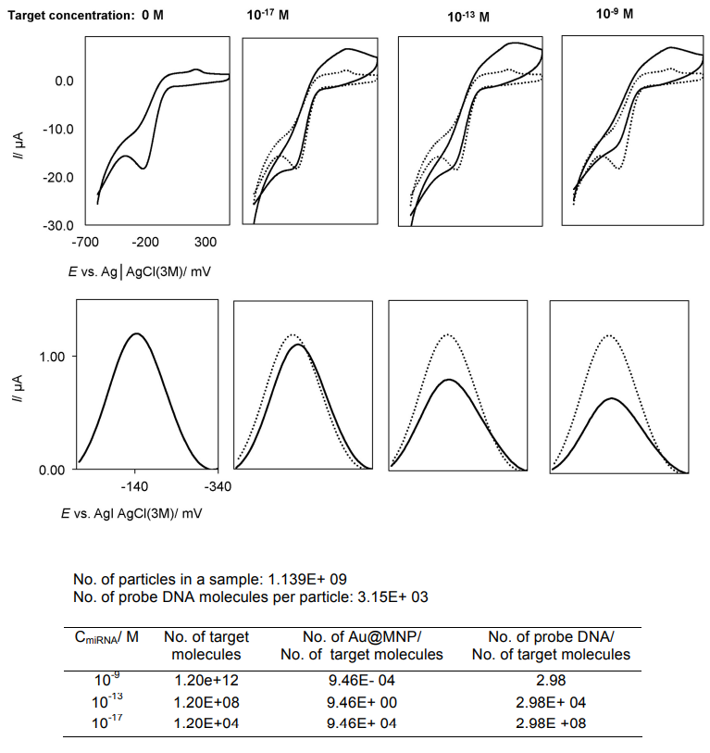
Evaluating Hypothesis 1 (Cont.)
Based on experiments with miR-21 spiked in PBS
Formation of a single double helix can “switch off” around 100,000 unhybridized Au@MNPs at 10 aM of miR-21
 | Concentration of target
 | 10 aM | 0.1 pM | 1 nM
% decrease in detectable redox-active molecules | 18.5 ± 2.6 | 23.0 ± 3.8 | 30.0 ± 4.1

Slide 18
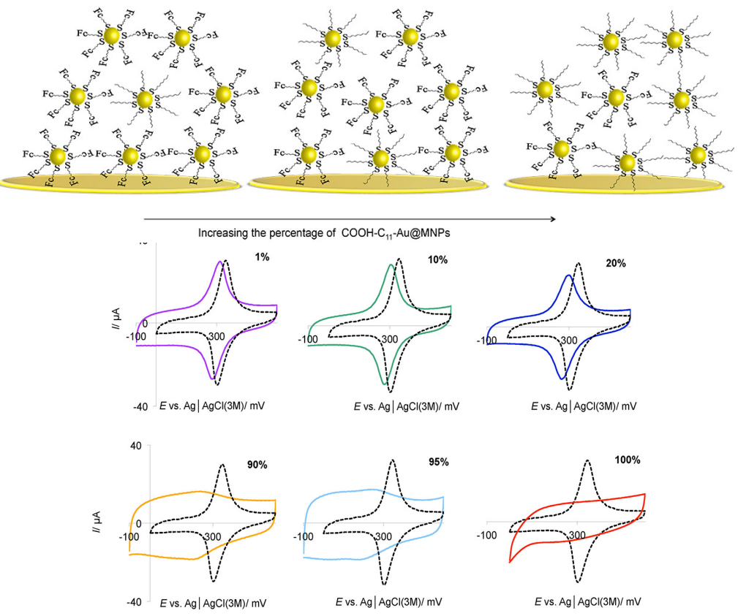
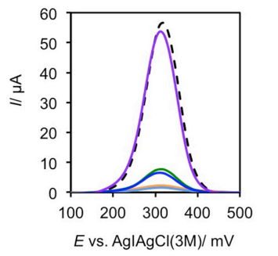
Evaluating Hypothesis 1 (Cont.)
To evaluate generality of first mechanism, 6-(ferrocenyl)hexanethiol and 1-mercaptoundecanoic acid were used to replace the DNA surface modifications
6-(ferrocenyl)hexanethiol acts as electro-active element
1-mercaptoundecanoic acid acts as insulating element, analogous to double helix formation
Results support hypothesis that long molecules on surface of Au@MNP impede electron tunneling through a network of Au@MNPs
Increasing percentage of insulating nano-particle in sample

Slide 19
Evaluating Hypothesis 2
Hypothesis 2: electric field induced reconfiguration of the Au@MNP network redirects hybridized particles closer to electrode surface, which helps to amplify signal suppression
Method:
Prepare suspensions of hybridized and unhybridized DNA-Au@MNP separately
Collect the suspensions onto the gold electrode in different orders
Take measurements before and after pulsing square wave signals for each order of collection

Slide 20
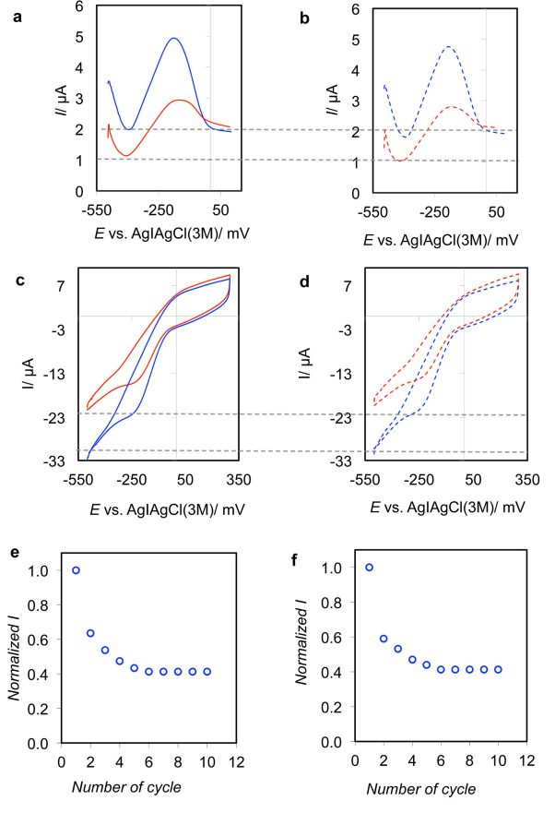
Evaluating Hypothesis 2 (Cont.)
Left column graphs shows result of hybridized portions collected first, followed by unhybridized portions. Right column graphs are from the reverse collection order
Lines show before (blue) and after (red) applying 10 cycle square wave pulse
Observations
Lower signal peaks with increasing number of pulse cycles
Current magnitude independent of collection order
Conjecture: hybridized DNA-Au@MNP are reconfigured closer to electrode surface due to applied electrical pulsing
Notes:
a & b are square wave voltammogram
c and d are cyclic wave voltammogram
e & f are normalized peak current from square wave voltammogram vs number of cycles

Slide 21
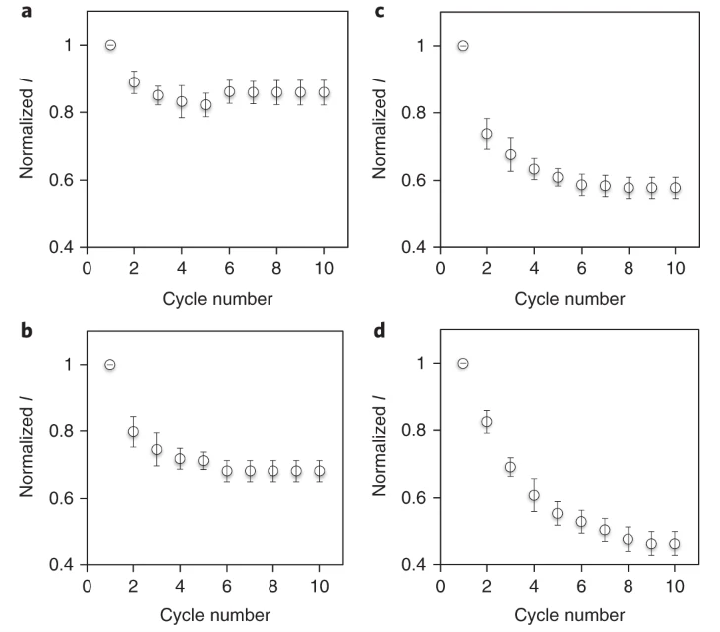
Evaluating Hypothesis 2 (Cont.)
Change in square wave current with cycle number for target concentrations of (a) 0 M, (b) 10 aM, (c) 0.1 pM, (d) 1 nM
Larger target concentration requires more cycles to stabilize current and leads to larger changes in current
electrical-pulsing-induced reconfiguration of DNA–Au@MNPs in the network happens to a greater extent in the presence of hybridized

Slide 22
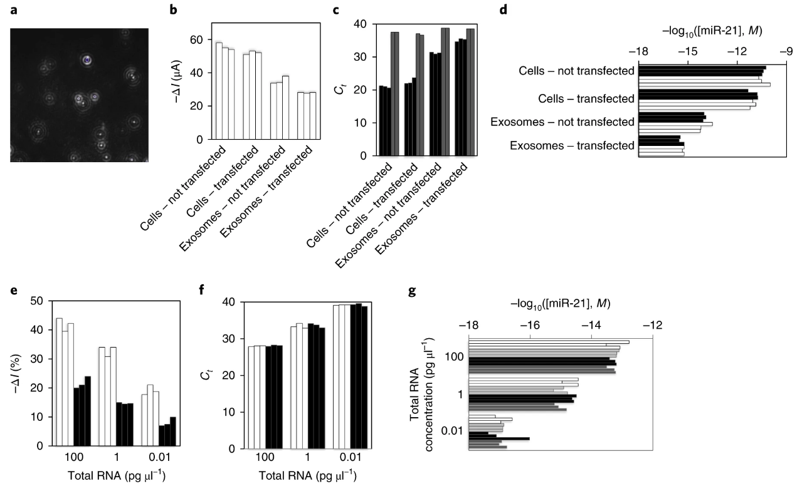
Examining Capability of Sensor
Detection in total RNA extract from human lung cancer cells (A549) and vesicles (exosomes) released by the cells
Notes:
Vesicles are kind of like a message object, includes miRNA, in cell-to-cell communication
Each bar represents independent experiment
(a) image of extracted exosomes of A549 lung cancer cells
(b) hybridization induced change in current for A549 cells and exosomes before and after transfecting with miR-21 inhibitor
(c) qRT–PCR results for same samples in (b). Black bar is the cycle threshold (Ct), higher means lower concentration. Grey bar is concentration of miR-39, used for normalization (d) comparison of data from (c) and (b)
(e), (f) white bar is PBS, black bar is 50% human blood. Test samples are diluted total RNA extracts from A549 cells
(g) summary of (e) and (f) electrochemical assay in PBS (white) and blood (black). qRT–PCR in PBS (light grey) and blood (dark grey)

Slide 23
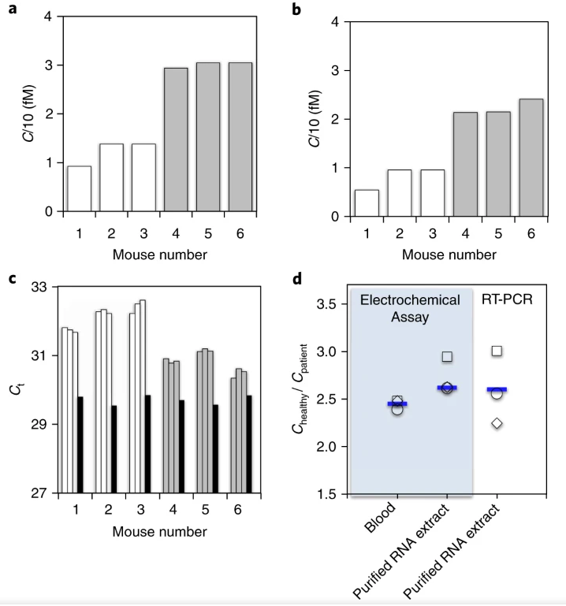
Examining Capability of Sensor (Cont.)
measuring miR-21 expression in whole unprocessed blood in a clinically relevant xenograft mouse model of human lung cancer
3 healthy mice, 3 mice with tumors
(a) electrochemical assay done on whole blood
(b) electrochemical assay done on RNA extract
(c) qRT-PCR done on RNA extract

Slide 24
Conclusion
Demonstrated direct analysis of miRNA in whole blood with high sensitivity within eight orders of concentration (1 nM–10 aM)
Results were consistent with qRT–PCR (gold standard) and analysis time takes only 30 mins
Device is low-cost
Since output signal is electrical, it is compatible with automation
Future work: the sensing concept could be tested for different biomarkers such as circulating DNA, or protein

Slide 25
Opinions?
Experiment parameters designed for broad range concentration
Is it possible to push the limit of detection further
Notes:
Could try other methods of voltammetry and see if there’s an impact on sensitivity
Experiments only carried out on 50% human blood, why not also verify viability on 100% human blood?
Textual description of the physical assembly could be complemented with figures/images for better clarity
Why 30 minutes of incubation time for nano sensor to mix with analyte? Is it the optimal time for the studied range of analyte concentrations? Instead or mixing gently with rotating wheel, can we speed up the mixing process?

Slide 26
References
[1] https://biomarkerres.biomedcentral.com/articles/10.1186/s40364-021-00272-1#Tab2
[2] https://pubs.acs.org/doi/10.1021/cm8025329
[3] https://onlinelibrary.wiley.com/doi/epdf/10.1002/anie.201202350

